Slide 1
Women’s Football Budget Expansion

Slide 2
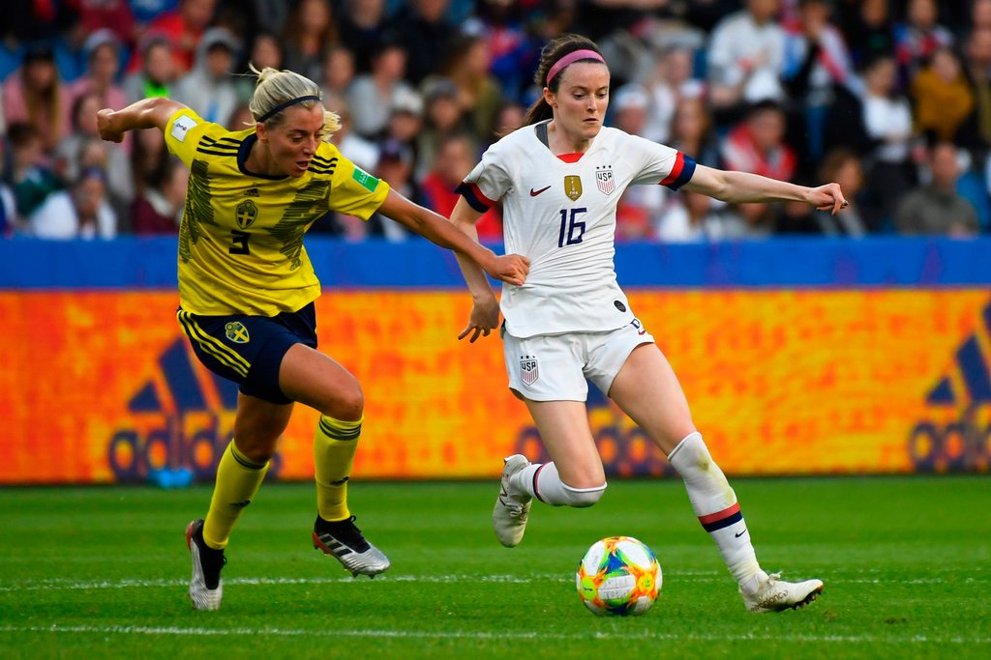
Objectives
Overview of Women’s Football
Participation and Interest
Growth
Viewership
Competitor overview
Nike
Adidas
Puma
Sponsorships
Major brands investing in sport
Why

Slide 3
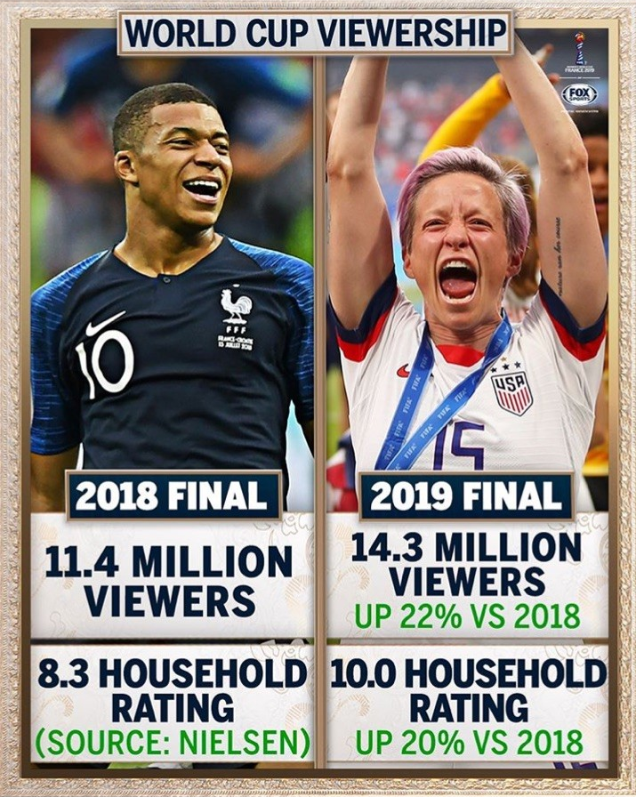
2019 FIFA Women’s World Cup Recap
“USA Women's home jersey is now the No. 1 soccer jersey, men's or women's, ever sold on Nike.com in one season," -Nike CEO Mark Parker
Investment in Women’s Football
Barclays: $13 million with FIFA
Arkema SA (French Chemicals Company): $1.13 million
FIFA: Doubled prize pool money
  2015: $15 million
  2019: $30 Million
As a result of increased sponsorships, FIFA has pledged to invest $500 million in the women's game and increased the World Cup team count from 24 to 32

Slide 4
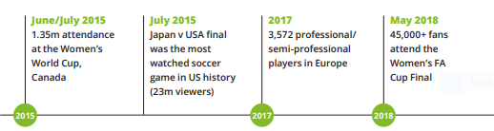
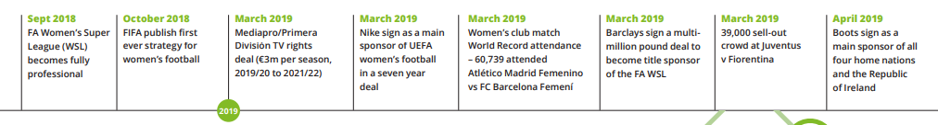
Recent Developments in Women’s Football: 2015-2019

Slide 5
Domestic Participation
“Interest in Football: Currently at 32%, up from 28% from four years prior. “ –Nielson.com
US participation: increased 4% since 2014
U.S. Youth Soccer
  Girls’ club soccer participation: 37% increase in the last 20 years
  HS soccer program participation: increased 45% increase between 1999-2014. –Forbes.com
1971: 700 High school female soccer players
2014: 376,000 High school female soccer players

Slide 6
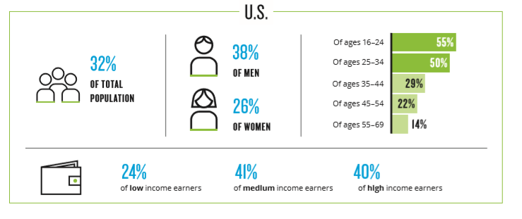
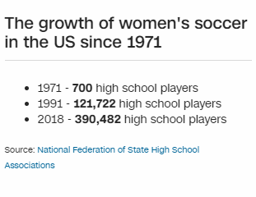
US Women’s Football Interest and Participation

Slide 7
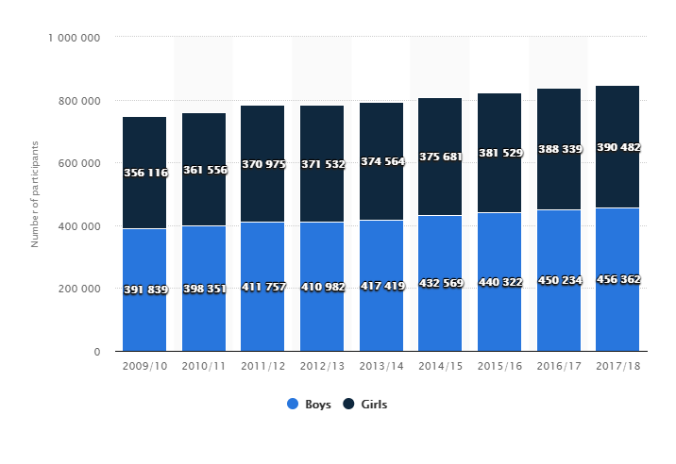
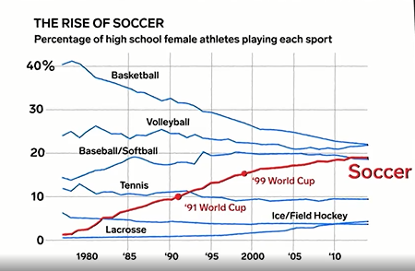
Number of participants in U.S. HS soccer from 2009/10 to 2017/18
US High School Participation
-statista.com

Slide 8
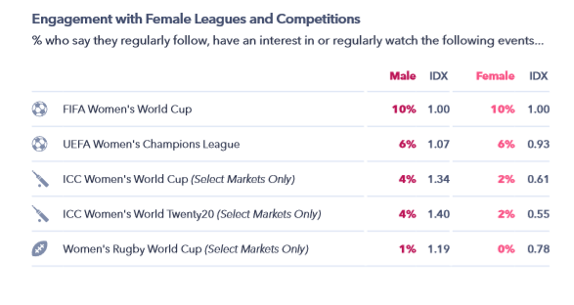
US Women’s Football Interest and Engagement

Slide 9
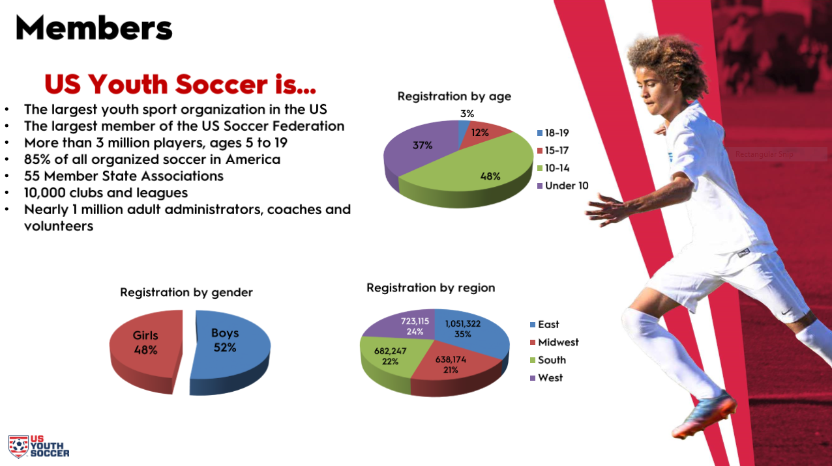
US Youth Soccer Participation

Slide 10
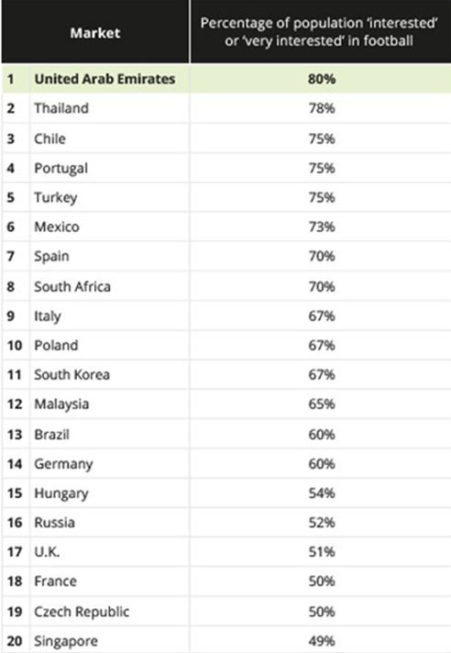
European Participation
2012 and 2017:
  Amount of pro or semi-pro players: more than doubled
  Number of national teams in Europe: 173 to 233.
  England, France, Germany, Netherlands, Norway and Sweden: Have more than 100,000 players
        “Spain has significantly improved its support for women's football.
        "The development in the last two to three years has been very good,“ –Spanish Team player Veronica Boquete” –DW.com
8 out of the top 20 soccer markets within EU
“131 million fans in the big five European markets (Spain, Italy, Germany, U.K. and France.)” –Nielson.com
Euro participation: 21 Million girls and women -Nielson.com
“1.3 million female players registered in Europe.” –CNBC.com

Slide 11
UEFA Women’s Football Statistics: 2012 to 2017
Total number of registered female players: Over 1.270 million.
Registered players U18: Over 827,000.
Youth leagues (U6 to U23): Grown from 164 in 2012/13 to 266 in 2016/17.
Six countries in Europe have more than 100,000 female players.
  France, Germany, Netherlands, Norway and Sweden
Number of pro and semi-pro players: Risen from 1,303 in 2012/13 to 2,853 in 2016/17.
52 countries have a women's national league
Number of national teams in Europe (including youth teams):
  Risen from 173 in 2012/13 to 233 in 2016/17.
17,553 qualified female coaches in Europe's national associations.

Slide 12
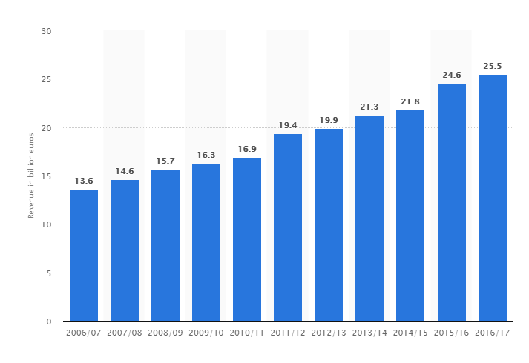
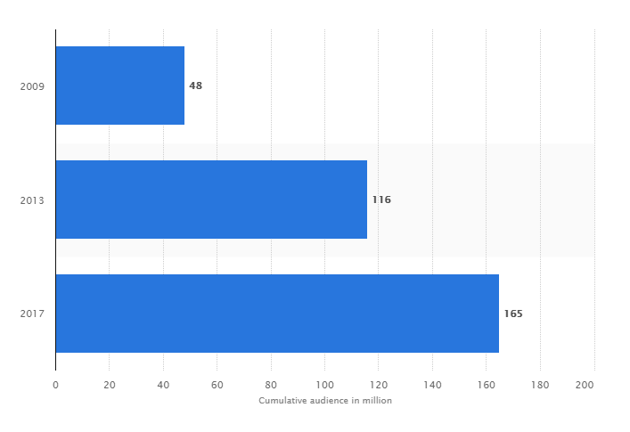
Market size of European pro football market: 2006/07 to 2016/17 (in billion euros)
25.5 billion euros = approximately 286 $billion
Cumulative audience of women's EURO football matches in Europe: 2009 to 2017 (in million people)
European Professional Football Market
displays the cumulative audience of the women's European Championship football matches in Europe from 2009 to 2017

Slide 13
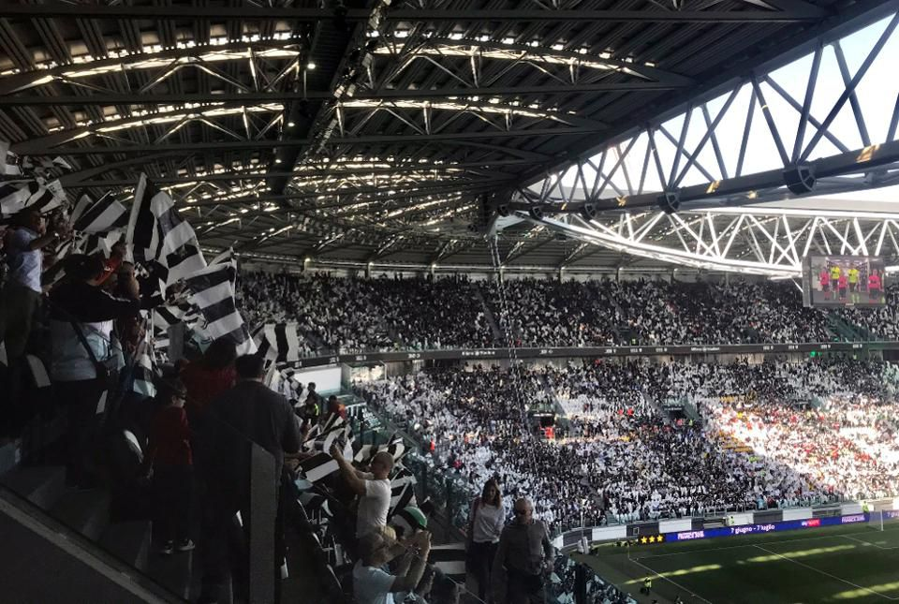
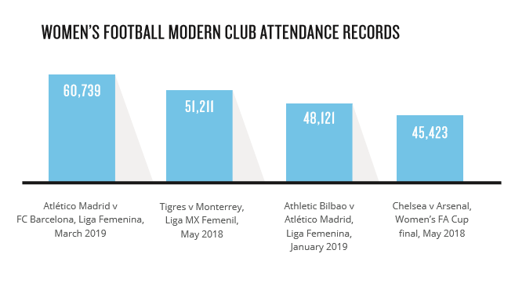
Viewership
UEFA Champions League
    Popular with 16-24 females
    2nd most watched annual event after NBA
Italy Record-breaking attendance
39,000 watched Juventus Women play Fiorentina Women
-3 times the previous record crowd of 14,000
60,739 watched Barcelona and Atletico Madrid in March 2019. record for a top-flight domestic women’s game.
“France’s domestic league negotiated a five-year agreement to have its games shown on national TV each week.” –LA Times

Slide 14
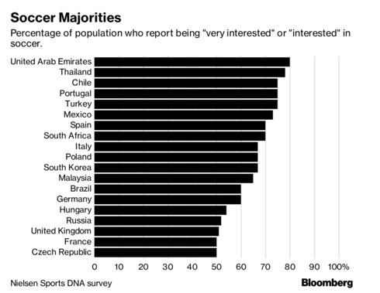
International Participation and Interest
“40% of the people in countries with a team competing in this year’s tournament are interested in women’s football.” -Nielson
“Global survey in major markets across the Americas, Europe, the Middle East and Asia shows the sport garnering powerful interest in more than 40% of the population.” –World Soccer Report, Nielson.com
187M: Number of people “interested” or “very interested in football in Urban China –Nielson.com World Football Report
“A love of watching soccer is a trend that cuts across the regions, Other than in North America (25%), soccer claims the top spot in the other regions, ranging from 45% engagement in Asia Pacific to 65% in Latin America.”
-Women’s Sports from Global Web Index

Slide 15
International Growth
FIFA Growth Goal: 60 million female players by 2026
England’s Women’s Super League (WSL): Add Manchester United and Tottenham Women’s teams. –CNBC.com
Real Madrid: announced plans to launch its own women’s team, following in the footsteps of rivals Barcelona –CNBC.com
2011-2015 world cup statistics
England
“2012 Olympics: England launches a five-year plan to grow women’s soccer; creation of an Elite Performance Unit , split off commercial and television rights from the men’s team.
2015: England won the bronze medal at the World Cup in Canada –USA Today
Spain
2015: La Liga took over the Spanish women’s league.
2018: Spain’s U17 won its World Cup while the U20 team reached the final –USA Today

Slide 16
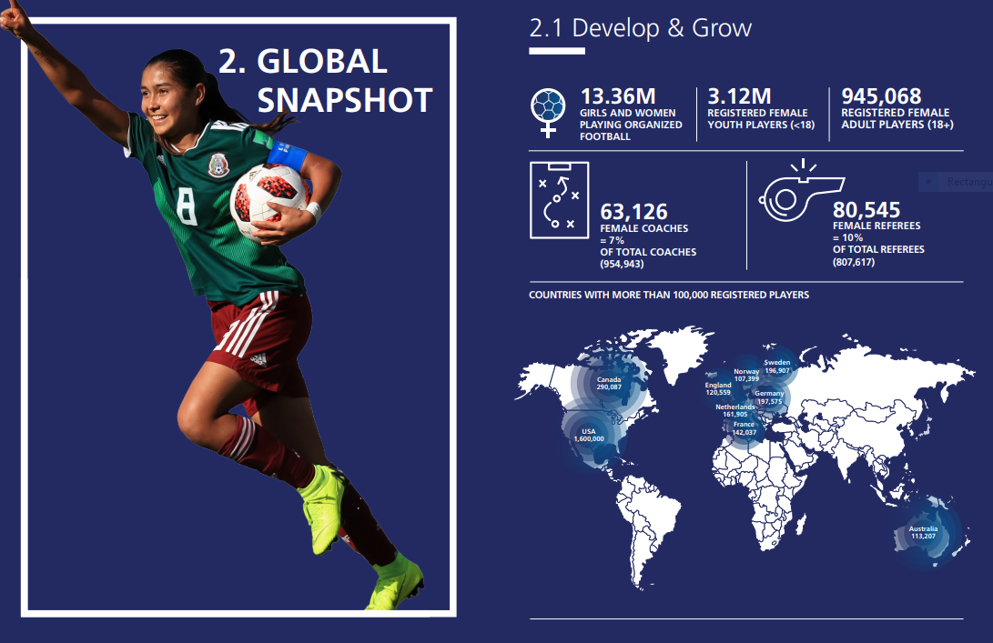
Global Participation
Major Countries with more than 100,000 registered female players
USA: 1,600,000
Canada: 290,087
Germany: 197,575
Sweden: 196,907
Netherlands: 161,905
France: 142,037
England:120,599
Australia: 113,207
Norway: 107,399

Slide 17
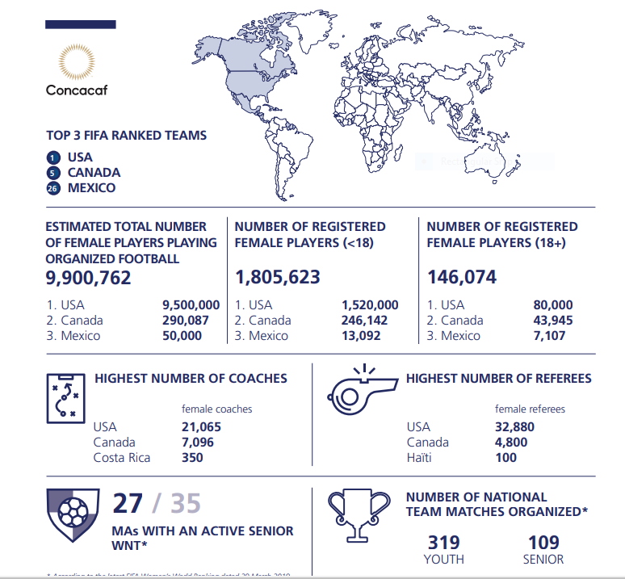
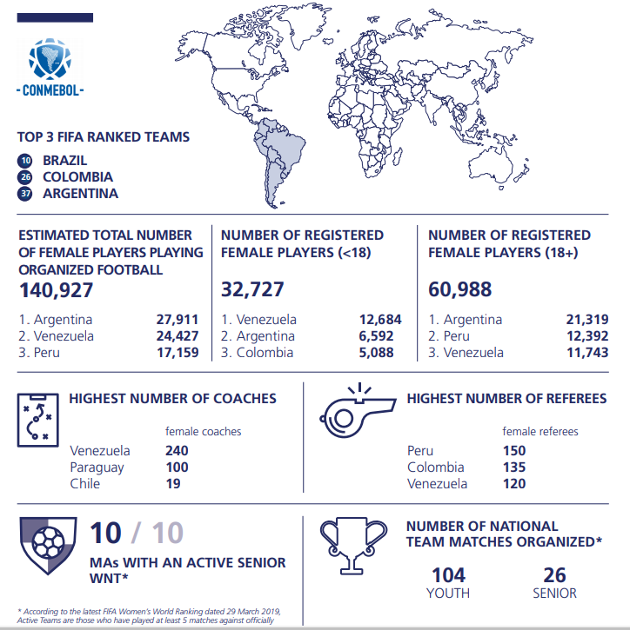
Concacaf Statistics
Global Federations: NA and SA
Conmebol Statistics

Slide 18
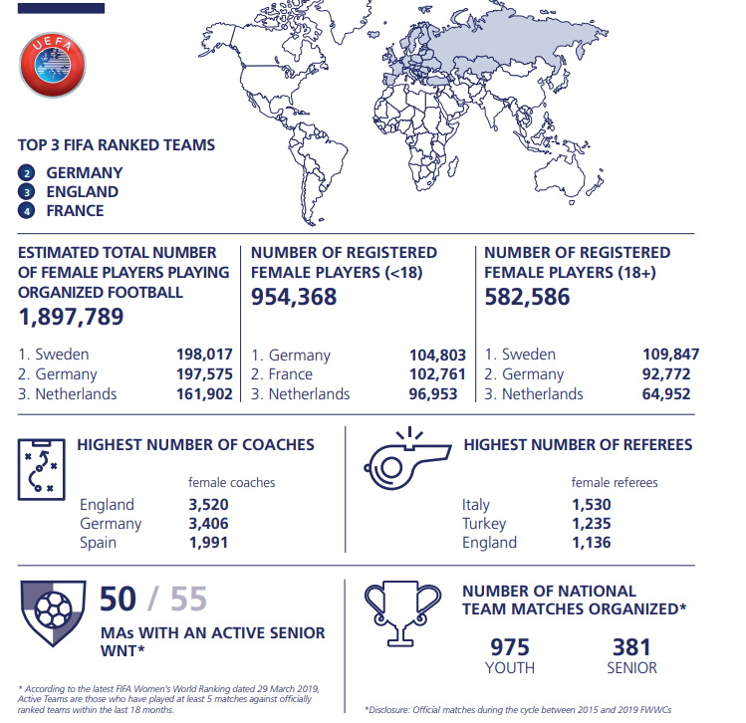
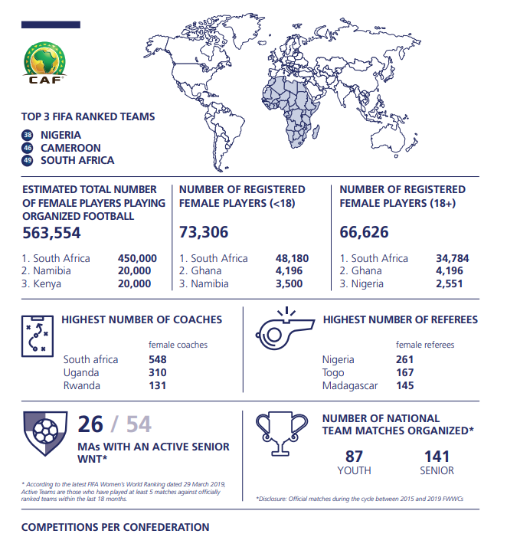
UEFA Statistics
Global Federations: EU and AF
CAF Statistics

Slide 19
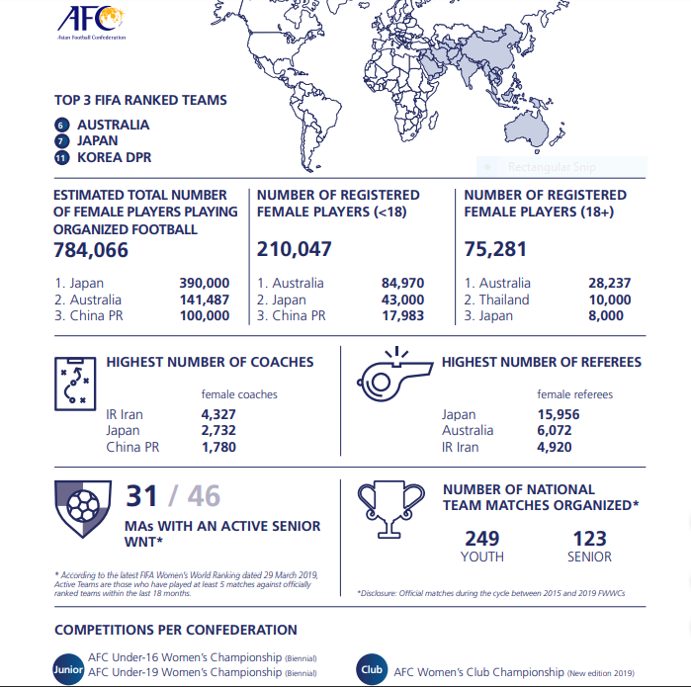
Global Federations: AS
AFC Statistics

Slide 20
International Growth: FIFA WWC Expansion Plans
“Expand Women's World Cup from 24 to 32 teams.”
“A women's version of the Club World Cup.”-ESPN.com
“A women's world league involving national teams”
“Infantino's final proposal dealt with the game at all levels. Having already pledged to invest $500 million in the women's game over the next four years, the president said Friday that FIFA will double that to a total of $1 billion in the same time span.”
  “He suggested some of that could be used for events like the global competitions he proposed, but that it would also go to grassroots efforts around the world.” –ESPN.com
“2019: 73% of member associations have an active senior women’s national team,
  “up 55% in 2015.”
  “18% more teams in the FIFA/Coca-Cola World Ranking have played at least five fixtures over the last 18 months.”
  –FIFA Women’s Football Member Associations Survey Report 2019
“Women's World Cup expanded from 16 to 24 teams in 2015.”-ESPN.com

Slide 21
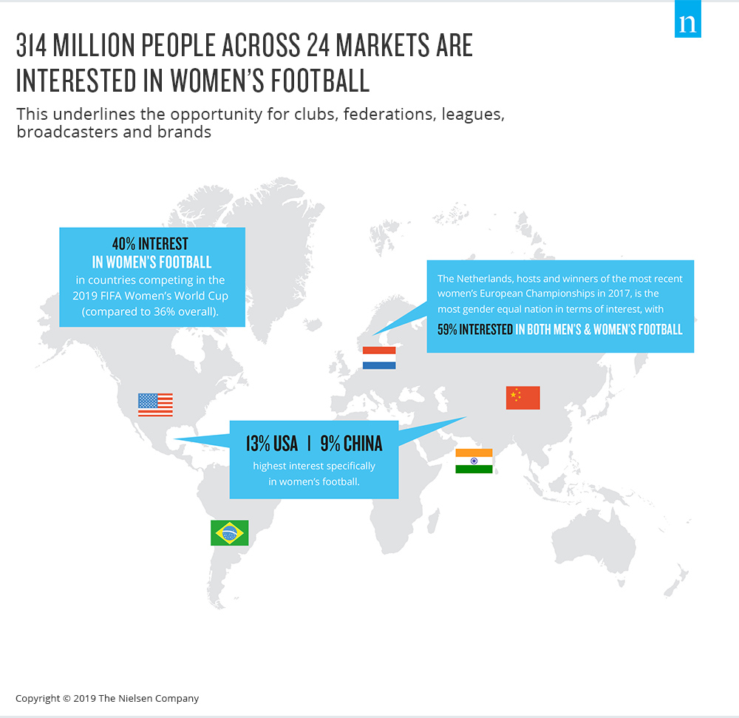
International Viewership
International Interest
more than 750 million television viewers watched FIFA WWC Canada 2015
  Up 1/3 from 2011 WWC.
Largest fan bases: China, India, Brazil, and US
“In the last two years, games in Mexico, England, the Netherlands, Spain, Italy and elsewhere have drawn record crowds of more than 30,000 for a women’s match” –LA Times
“#1 most popular sport in the world” –World Atlas.com

Slide 22
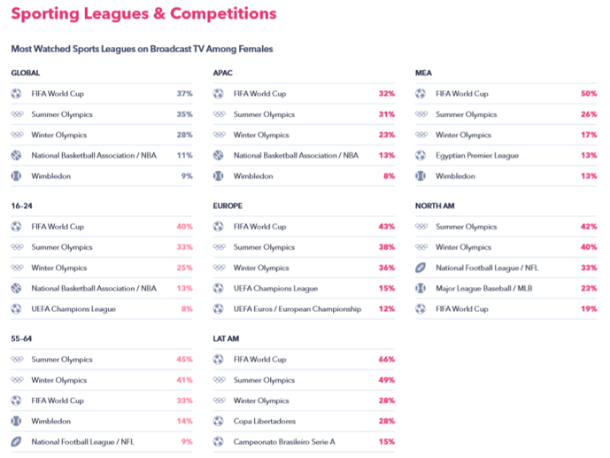
Broadcast T.V. Female viewership
UEFA Champions League
popular with 16-24 females
2nd most watched annual event on broadcast TV among this demographic, after NBA
Globally, NBA comes top for broadcast TV viewership

Slide 23
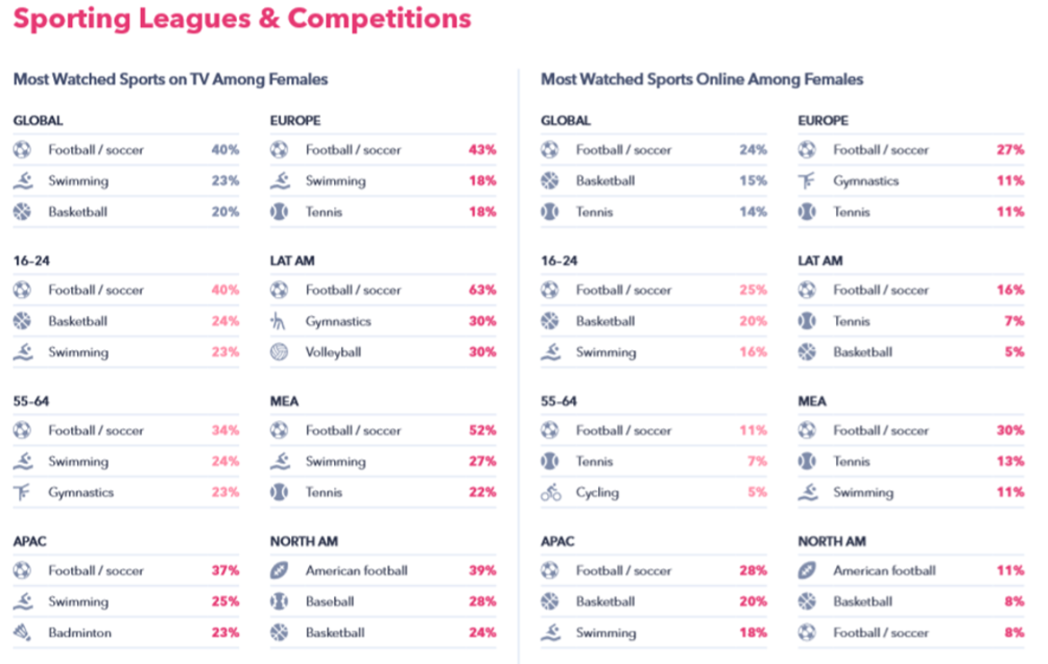
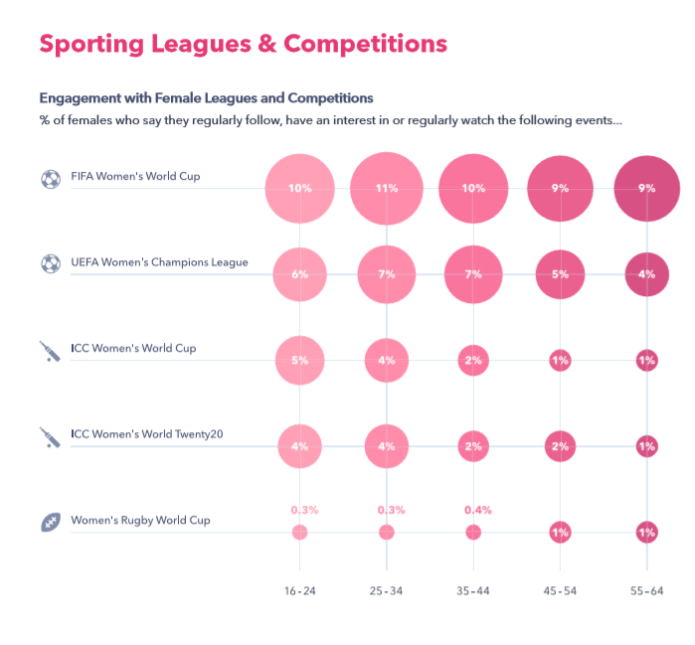
Television Female Viewership and Sport League Engagement

Slide 24
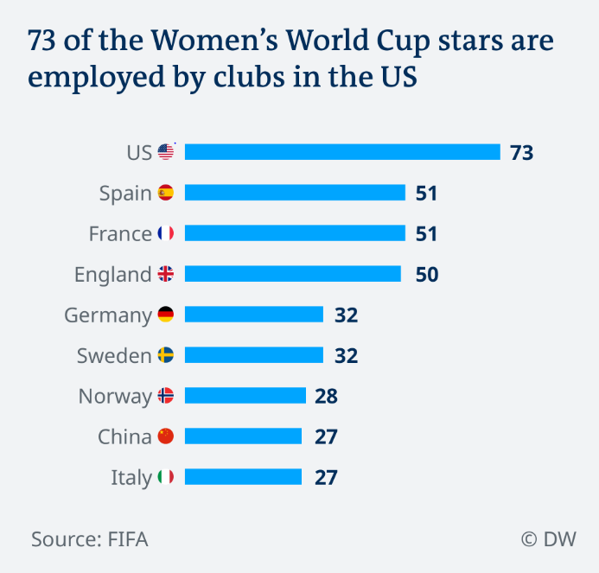
Major Countries
Major Soccer Markets: Where World Cup stars are employed
“France, England and Spain: top destinations for players in recent years.
“Spain's national women's team qualified for the World Cup for the first time in 2015.”
  -Gitta Axmann, Institute of Sociology and Gender Studies at German Sport University Cologne.
2015: 21 WWC athletes total played for FC Barcelona, Atletico Madrid or other top Spanish teams
2019: 51 players from 12 different national teams play for Spanish clubs — including all but three of the women on Spain's squad itself

Slide 25
Competitor Overview: Nike
March 2018: launches 14 national team kits ahead of the FIFA WWC.
Served to showcase the brand’s commitment to women’s sport
Made a 3-year partnership with UEFA covering the UEFA governing body’s women’s competitions.
Match-ball sponsor and support UEFA’s #WePlayStrong campaign.
Announced partnerships with institutions around the world, supporting the development of female athletes and women’s coaches.
piloting a program to provide specific products such as hijabs and sports bras, with a focus on “women’s-specific precision engineering.”
Jersey sales increased 200% over the last tournament 4 years ago.
Several countries joined US in selling the women’s designs in men’s sizes, nearly doubling the number of men’s jerseys sold over the previous tournament (2015).
Sales of women’s tournament related apparel: up more than 150% over 2015.” –Soccerbible.com
Training and lifestyle extensions of the National Team Collections for Brazil, Nigeria, Chile, and China were popular as well
On Feb. 27, Nike signed a professional contract with 13-year-old Olivia Moultrie

Slide 26
Competitor Overview: Adidas
March 2018: FIFA WWC winning team athletes will receive the same performance bonus payment as male footballers.
-Nielson.com
FIFA Women’s World Cup 2019: Adidas did not make women’s jerseys available in men's sizes for some countries including Spain, Sweden, and Germany.
Arsenal signs new kit deal with Adidas beginning in July, 2019. –CNBC.com
New deal: £300 million ($391 million) over five years. –CNBC.com

Slide 27
Competitor Overview: Puma
Goal: “Gain market share,”
Plan: “Make sure that there’s no part of the world where there’s football without Puma.”
- Puma’s head of sports marketing, Johan Adamsson
“Puma has signed three top-flight soccer clubs — AC Milan, Olympique Marseille und Borussia Mönchengladbach”
“Puma has sought to rebuild its reputation in sports performance gear with signings” –Reuters.com
Feb. 2019: Puma signs partnership Manchester City
“Deal could be worth 50 million pounds ($67 million) a year” -Reuters.com
“Deal could be worth up to £65m a year for 10 years.” -BBC.com

Slide 28
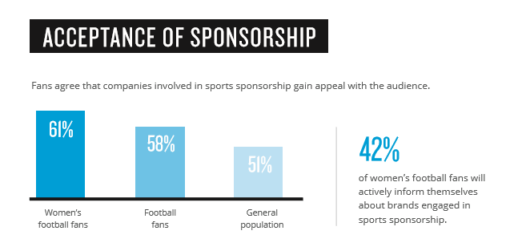
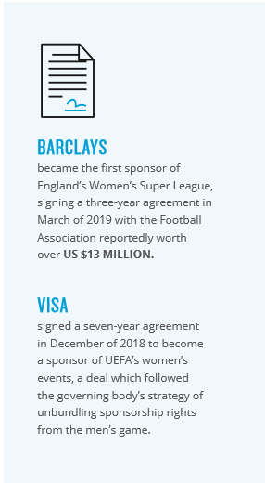
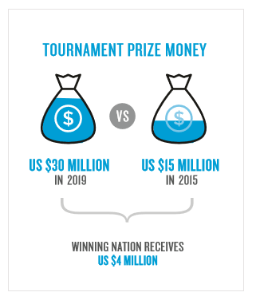
Sponsorship
FIFA Women’s World Cup Prize Money
2015 to 2019
“Twenty-one million women and girls participate in the beautiful game across Europe and at Visa we want to celebrate every single one of them,” - Charlotte Hogg, CEO, Visa Europe

Slide 29
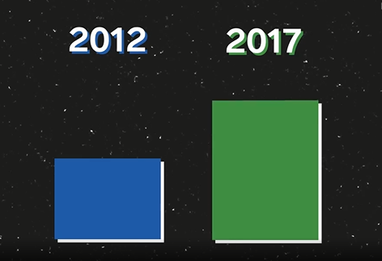
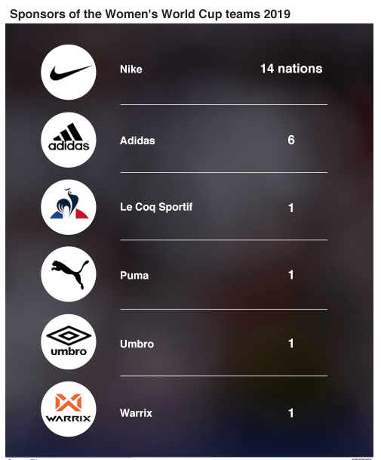
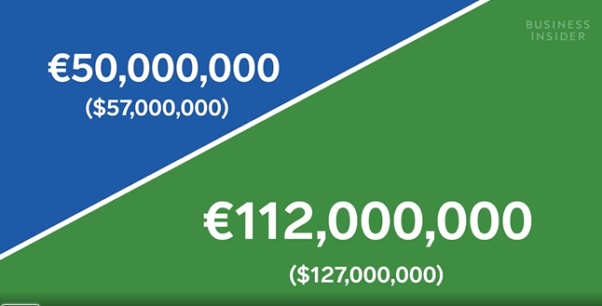
Sponsorships
European Women’s Soccer Investment 2012-2017
With more money, “you might have access to better trainers, to better fitness instructors, to strength coaches and even to start specializing particular coaching areas”
Eileen Narcotta-Welp, Assistant Professor and Soccer Scholar at University of Wisconsin- La Crosse

Slide 30
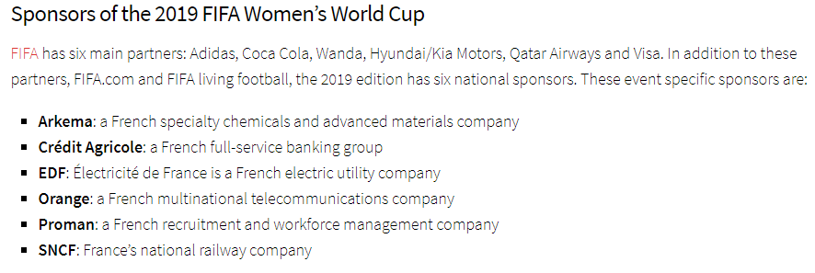
Sponsorships
“Chemicals company Arkema SA: three-year contract for the naming rights with the top women’s professional league
  “1 million euros ($1.13 million) a year” –Bloomberg.com
Budweiser: March 2019 Extended contract with FA and became official beer sponsor of England’s national team
List of Brands sponsoring World Cup Final Match
Nike
Volkswagen
Walt Disney Pictures (“Mulan,” “The Lion King”)
Wells Fargo
SoFi
Verizon
Google Nest
State Farm
Hotwire
Geico, Coca-Cola, Visa and Pizza Hut.
FIFA plans on increased prize money for the 2023 WWC:
  "Moving ahead for the next World Cup, we will double it,“ -FIFA President Gianni Infantino, per ESPN.com
“France’s domestic league negotiated a five-year agreement to have its games shown on national TV each week.” –LA Times

Slide 31
Sponsorships
December 2018: Visa signed a seven-year deal to become the first ever sponsor of UEFA women’s football, becoming the main partner of flagship events such as the UEFA Women’s Champions League and the UEFA Women’s European Championship⁴.
March 2019: Nike signs a five-year exclusive deal with UEFA Women’s Football to supply their ball to all UEFA women’s competitions.
Barclays will become the title sponsor of the FA WSL in a multi-million pound sponsorship deal
  the largest ever investment in UK women’s sport by a brand.

Slide 32
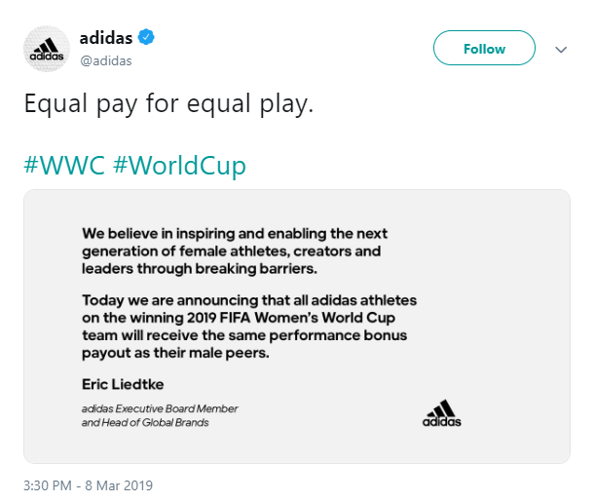
Reasoning behind Increased Sponsorship and Investment
Barclays
“Our commitment to women’s and girls’ football, at a crucial time in its development, goes beyond pure sponsorship – we believe it can be a key to increasing participation, development and the wider visibility of the female game.” -Jes Staley, Group CEO of Barclays
Boots
Entered women’s sports scene for two reasons:
1.) The growing popularity of the sport
2.) The opportunity to leverage customer insights relating to the link between playing sport and feeling confident.”
“Women’s football has never been more popular. With our reach up and down the country, we have a huge opportunity to bring their [players’] stories to life and hopefully inspire the next generation.”
-Boots UK Marketing Director Helen Normoyle
FIFA Organization
"We can develop national team football only if we develop club football as well, all over the world, not only in a few countries," Infantino said.
"So we need a Club World Cup, which can be played every year to expose clubs from all over the world. And to make clubs, men's clubs but also women's clubs, invest even more in women's football.“ –FIFA President Gianni Infantino, ESPN.com

Slide 33
Visa and UEFA Sponsorship Deal
December 2019: Visa became the first ever independent sponsor of the women’s game under the UEFA umbrella.
Seven-year partnership running through to 2025
VISA will support the women’s game across:
  UEFA Champions League and
  European Championship competition
  U19, U17, and European Futsal tournaments

Slide 34
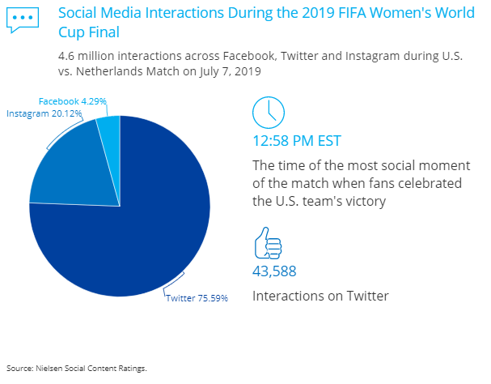
Media
“France Football magazine is now devoting full pages to women’s matches and women players, even granting its first women’s award, Ballon D’Or, last year to a Lyon club player, Ada Hegerberg.” –Bloomberg.com
“850-plus women’s-soccer-themed videos produced by companies in the weeks leading up to WWC” –AdAge.com
In 3 months there were 72 million views “across all social media platforms, according to video measurement company Tubular.”-AdAge.com as of 7/6/19
-Nielson.com
Nike Football Instagram: @nikefootball
  Since May 12 (a month before the tournament kicked off) 35 of the 40 posts going out to the 40m followers were focused on women's football.

Slide 35
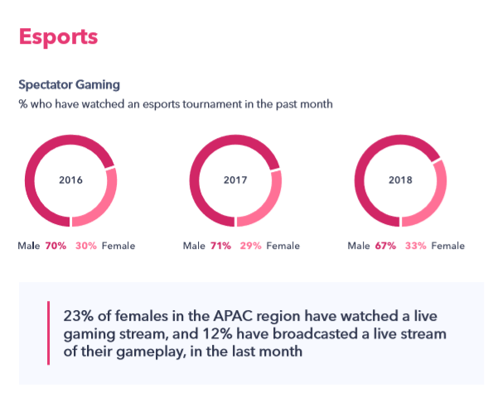
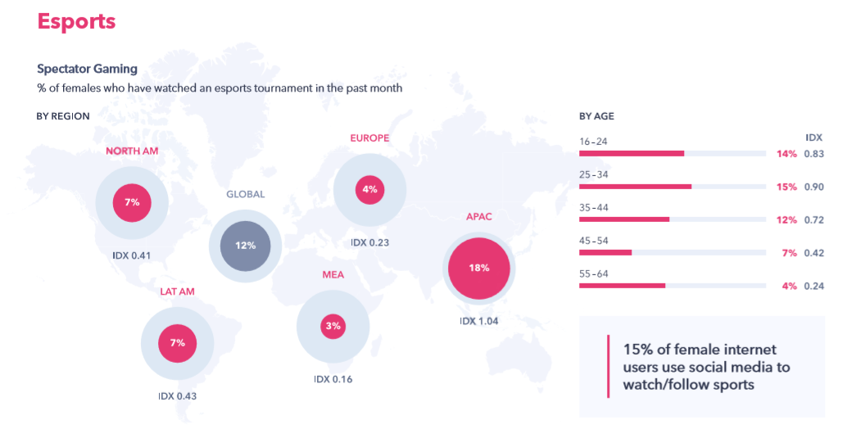
Spectator Gaming: E Sports Slide FIFA, EA Sports

Slide 36
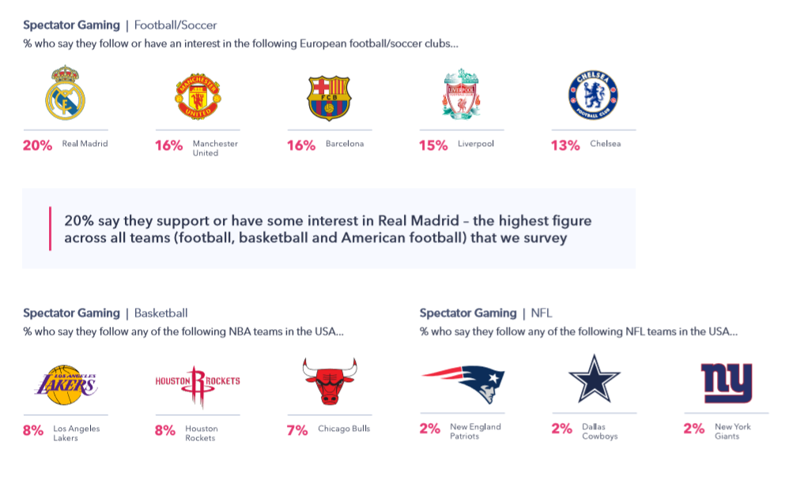
Spectator Gaming: Brand and Team Preferences

Slide 37
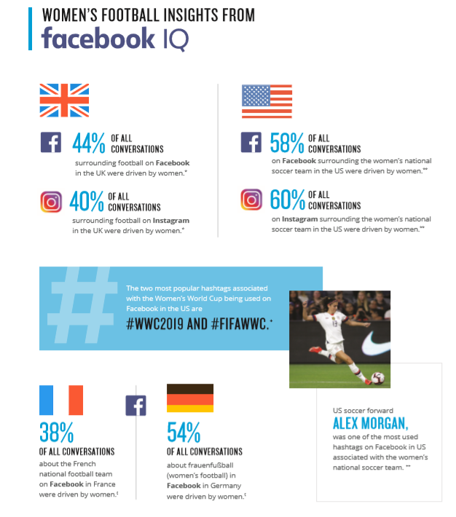
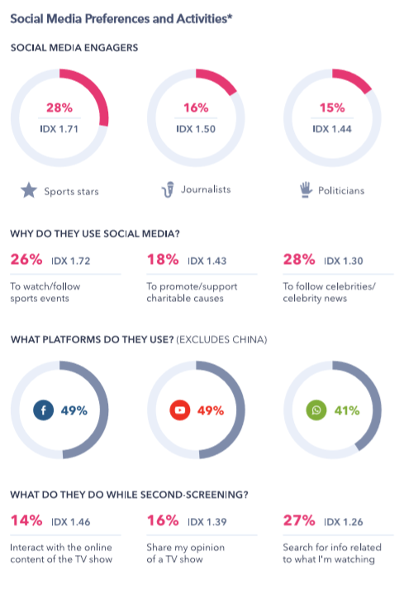
Social Media Use and Preferences

Slide 38
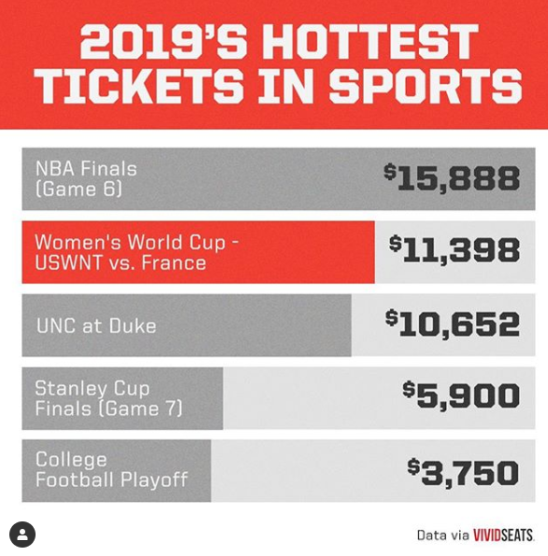
2019 FIFA Women’s World Cup Quarterfinal Match: USWNT vs. France
“The Women’s World Cup has only confirmed this growing interest, with stadiums like the 48,000-seat Parc des Princes sold out for most of the matches”
    –Bloomberg.com
FOX Sports: 6.3 million watched 2019 FIFA WWC quarterfinal match of France vs. US
Television
FOX: 6,335,000 viewers -Nielsen fast national numbers
8,239,000 peak during the broadcast
Most-watched FIFA WWC quarterfinal on record in U.S.
Most-watched soccer match on English-language U.S. television since last year's FIFA World Cup.
7% increase from the 2015 quarterfinal match between the U.S. and China (5,736,000 viewers)
57% increase from the quarterfinal match in 2011 (3,890,000 viewers)
Ticket Prices for USWNT vs. France

Slide 39
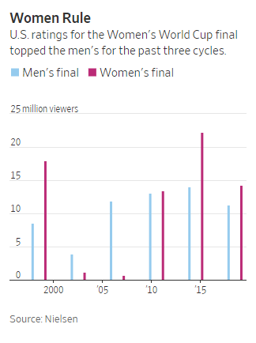
2019 FIFA Women’s World Cup Final Match
“USA Women's home jersey is now the No. 1 soccer jersey, men's or women's, ever sold on Nike.com in one season," -Nike CEO Mark Parker
FOX Sports: “U.S. victory averaged just a hair shy of 14 million linear TV viewers—a number that jumped to 14.3 million upon application of streaming deliveries—making this the third most-watched women’s soccer match in history.” –Nielson.com
“Sunday’s World Cup final audience of 15.6 million viewers was also larger than four of the six 2019 NBA Finals contests between the Toronto Raptors and Golden State Warriors.”
–LA Times

Slide 40
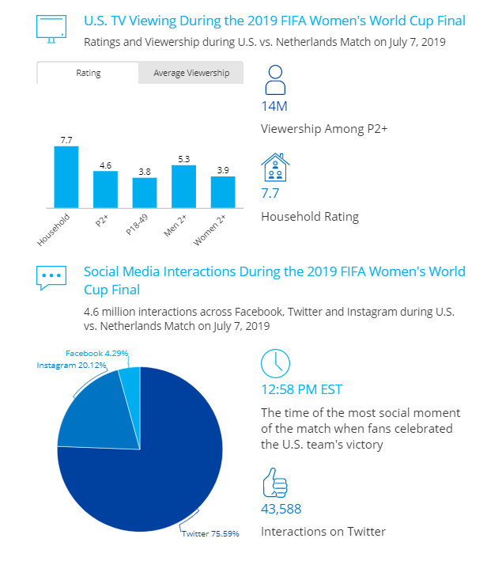
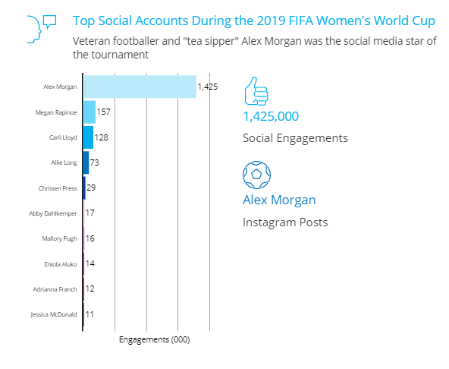
2019 Women’s World Cup Media Snapshot

Slide 41
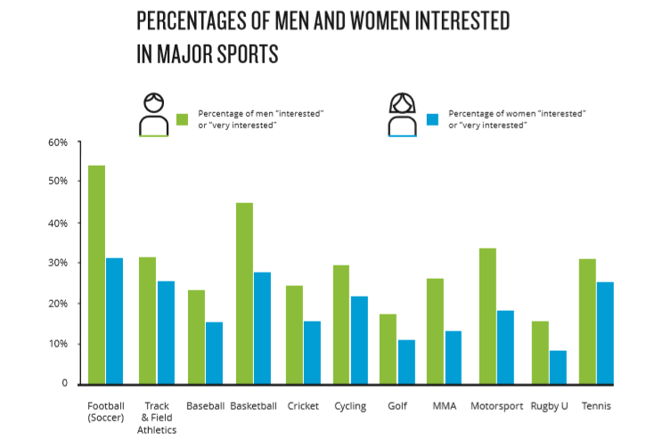
Women’s Football Interest

Slide 42
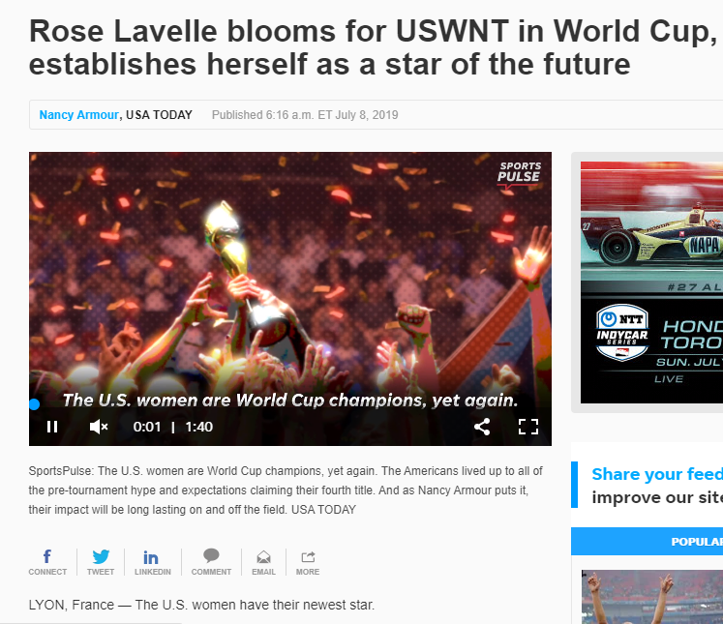
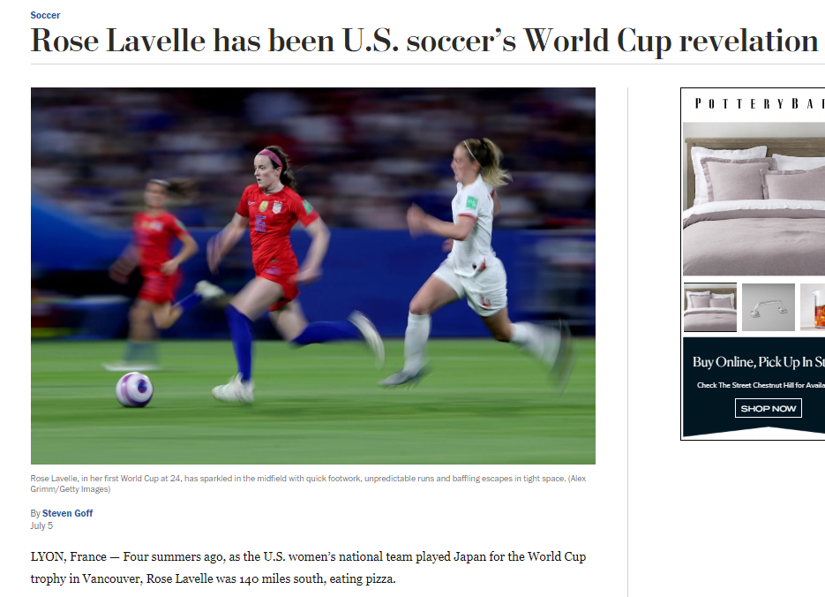
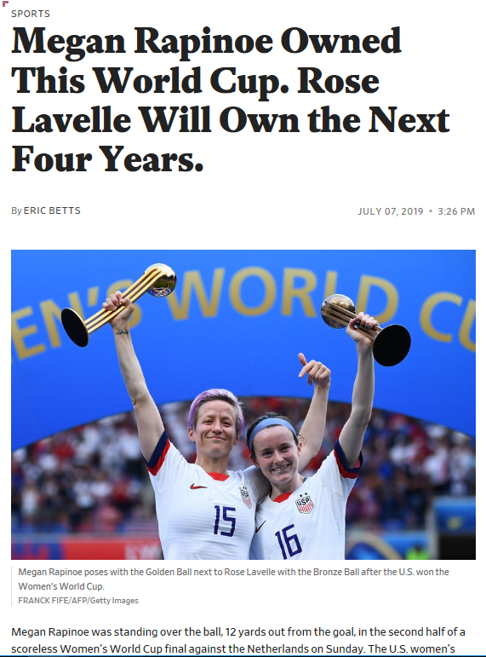
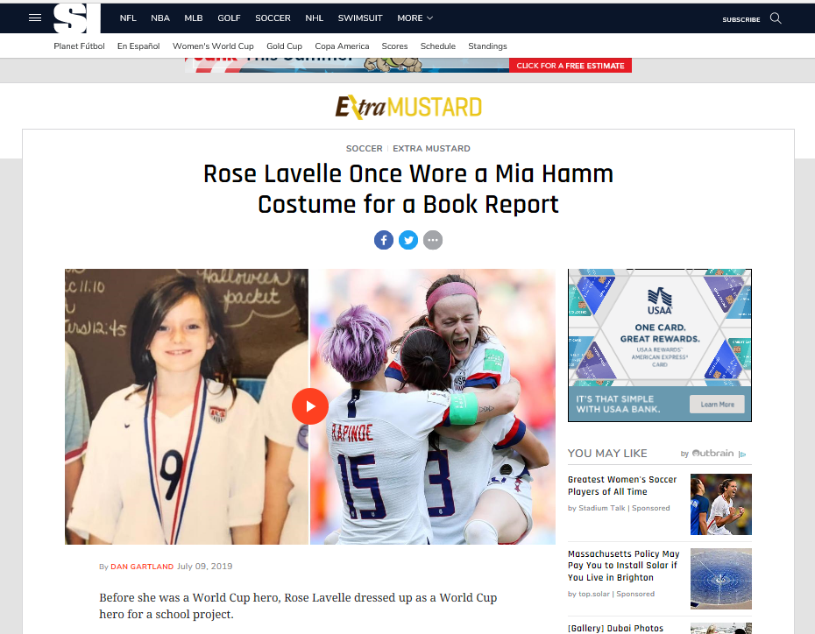

Rose Lavelle

Slide 43

Rose Lavelle

Slide 44

Rose Lavelle: Fighting for Equal Pay
“We need kind of sustainable income so that people can feel like this is their full-time job. I think right now, the reality of just women’s sports in general is that they can’t devote their whole life to what they love,” she said. “I just feel like the next step is that we need to make everyone feel like they are a professional athlete.” –Rose Lavelle, Seattle Times

Slide 45
Men’s vs. Women’s Salary Differences
Men’s Leagues and Salaries
Women’s Leagues and Salaries
MLS:
Reserve Minimum Salary: $56,250
Senior Minimum Salary: $70,250
USMNT*:
$263,320 ($13,166 per game)
EPL:
Average EPL players makes $3.3 million
World Cup: $38 million for France’s 2018 Men’s Championship team
NWSL
Minimum Salary: $16,538
Maximum Salary: $46,200
USWNT*:
$99,000 ($4,950 per game)
World Cup: $4 Million
*Salaries based of condition of if each team played and won 20 exhibition matchups, per Goal.com.
https://heavy.com/sports/2019/07/usa-women-uswnt-soccer-salary-men-usmnt-world-cup/

Slide 46
Men’s vs. Women’s Salary Differences cont.
Max Earnings for the USMNT: $1.1 Million
Max Earnings for USWNT: $200,000 for the USWNT –heavy.com
“$31,250 per player difference between the men’s and women’s roster bonuses for making the World Cup.” –heavy.com
“LUNA Bar is closing the World Cup roster bonus pay gap by giving each of the 23 women named to the 2019 World Cup team the $31,250 difference to make their roster bonus equal to the men’s.” -CLIF Bar
USNT Performance Differences: Men’s vs. Women’s Squads
US Men’s National Team
US Women’s National Team
“2016-2018: Men’s games produced men's games $49.9 million in revenue”
  -Business Insider
“USWNT: generated more revenue since 2016 than the men's team” -WSJ
“2016-2018: Women's games brought in $50.8 million”
-Business Insider
“The women's team revenue spiked in 2016 after WC victory, outpacing the men's team's earnings by $1.9 million” –Business Insider

Slide 47
Online Sources- Rose Lavelle Slide 1
Sports Illustrated:
https://www.si.com/soccer/2019/07/09/rose-lavelle-uswnt-world-cup-mia-hamm-costume-photo?utm_medium=social&xid=socialflow_facebook_si&utm_campaign=sportsillustrated&utm_source=facebook.com
SB Nation:
https://www.sbnation.com/soccer/2019/7/7/20684951/rose-lavelle-uswnt-future-world-cup-final
USA Today:
https://www.usatoday.com/story/sports/soccer/worldcup/2019/07/08/world-cup-2019-rose-lavelle-star-future-uswnt/1669783001/
Washington Post:
https://www.washingtonpost.com/sports/2019/07/05/rose-lavelle-has-been-us-soccers-world-cup-revelation/?utm_term=.9fd033c47120
LUNA Bar Equal Pay source:
https://www.clifbar.com/article/someday-a-woman-s-goal-will-be-worth-as-much-as-a-man-s-someday-is-now
FOX Sports on Facebook
https://www.facebook.com/112638779551/posts/10158717780979552?s=57401873&sfns=mo
FOX Sports Article:
https://www.foxsports.com/soccer/story/uswnt-rose-lavelle-world-cup-title-jill-ellis-070719
Slate.com
https://slate.com/culture/2019/07/uswnt-wins-world-cup-megan-rapinoe-rose-lavelle.html

Slide 48
Online Sources: Rose Lavelle Fighting for Equal Pay
CNN Facebook Equal Pay Video:
https://www.facebook.com/5550296508/posts/10159675768091509?s=57401873&v=e&sfns=mo

